Slide 1

Exploratory Data Analysis of Historical UFC Fight Data
Final Capstone | Thinkful | Data Analytics
By Maxine Cox

Slide 2
Background
Company
Context
Research
The Ultimate Fighting Championship (UFC) is an American mixed martial arts promotion company.
In the years since its inception in 1993, UFC has increased in popularity and achieved MSM coverage.
The purpose of the early UFC was to identify the most effective martial art in a contest with minimal rules.
Disciplines, like boxing, BJJ, sambo, wrestling, Muay Thai, karate, and judo were represented.
In 2000, the UFC became sanctioned by the Nevada State Athletic Commission
Since then, the sport has grown and mixed martial arts has morphed into a more distilled discipline.
Notes:
When the UFC began, the idea was to have a tournament that would feature martial artists from different disciplines facing each other in a no-holds-barred combat to determine the best martial art.
Immediately, the Gracie family-- who developed Brazilian jiu jitsu-- started to dominate. Before there were weight classes, you could see BJJ practitioners winning fights against martial artists from other disciplines that were much bigger in size.
As time went on, mixed martial arts began to distill into a discipline of its own as martial arts that proved more effective became apparent. There was a time when a black belt in jiu jitsu had an advantage against someone who did not. Now any fighter worth their salt is an elite jiu jitsu practitioner.
I want to look at the evolution of number of fights that end in K.O’s or T.K.O’s (knock out or technical knockout) vs. submission over the years.
Based on the above observations, I postulate that striking has become more important again, and now the fighter with the best kickboxing/muay thai has the upper hand. So, to state my hypotheses:
Wins by submission over time. Hypothesis is that it's gone down over time.
Number of takedowns over time. Hypothesis is that it’s gone down over time.

Slide 3
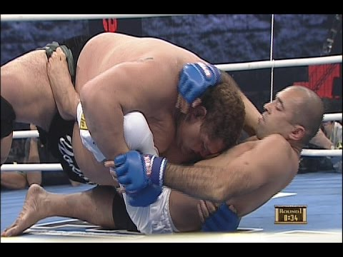
Brazilian jiu-jitsu in the UFC
BJJ is founded on the concept that a smaller, weaker person can successfully defend themselves against a bigger, stronger opponent by using technique, leverage, and taking the fight to the ground.
BJJ utilizes submissions-- joint locks and chokeholds-- to defeat the opponent.
Royce Gracie used Brazilian jiu-jitsu in the early years of UFC to defeat opponents of greater size and strength.
Royce (6'1" 180 lbs) submitted Legendary Sumo Grand Champion Akebono (6'8" 486 lbs) in 2004.

Slide 4
The first UFC fight.
Popularity begins to pick up
Current day, there were 474 UFC fights in 2018.
2018 on >
1993
2000
2009
10.20.XX
2013
Ronda Rousey, Conor McGregor, among others start to get MSM coverage.
UFC becomes a sanctioned sport.
Notes:
Most of my statistical uses data starting after the year 2000, due to that being the year the UFC became a sanctioned, regulated sport. Standardized weight classes and rules were imposed at that time.

Slide 5
Hypotheses
Since BJJ has become a necessary skill to do well in MMA, I came in with two main hypotheses to test:
That the proportion of fights ending in submissions has gone down over time.
That the proportion of successful takedowns has gone down over time.
Notes:
As time went on, mixed martial arts began to distill into a discipline of its own as martial arts that proved more effective became apparent. There was a time when a black belt in jiu jitsu had an advantage against someone who did not. Now any fighter worth their salt is an elite jiu jitsu practitioner.
I want to look at the evolution of number of fights that end in K.O’s or T.K.O’s (knock out or technical knockout) vs. submission over the years.

Slide 6
Methods:
Cleaning/Wrangling
Exploratory data analysis
Hypothesis testing
Imported a dataset from Kaggle with fight data from 1993 to present.
Delimited the raw CSV, converted columns to correct data types, and added weight class column.
Conducted initial analysis.
Used Pandas, MatPlotLib, Seaborn, Numpy, Scipy and Statsmodels libraries in a Jupyter notebook to analyze and visualize the data.
Used a z-test to test the fights from 2000-2009 against 2010-2019, looking for a statistically significant difference between the proportions of successful takedowns/submissions over the years.

Slide 7
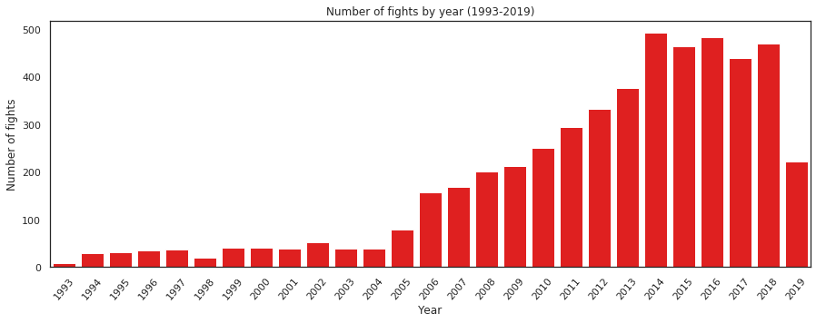
How many fights have taken place per year since 1993?

Slide 8
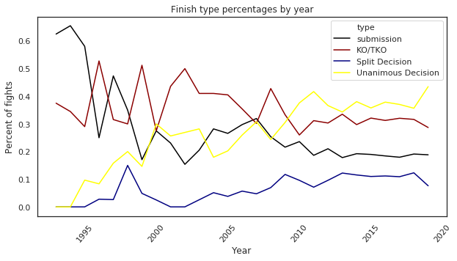
Evolution of finish type
Compared submissions, KO/TKO, and decisions over time.
Unanimous and split decisions have been on the steady rise.

Slide 9
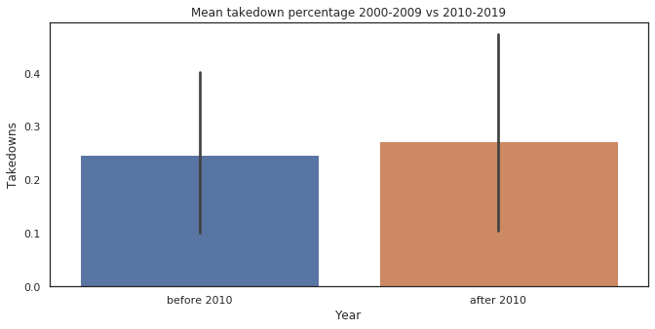
Takedowns - Hypothesis test results
Took two samples: fights from 2000-2009 and 2010-2019.
Ho: p1 - p2 = 0
Ha: p1 - p2 ≠ 0
P = 0.844
Cohen’s d is -0.092.
Fail to reject the null: no statistically significant difference in successful takedowns over time.

Slide 10
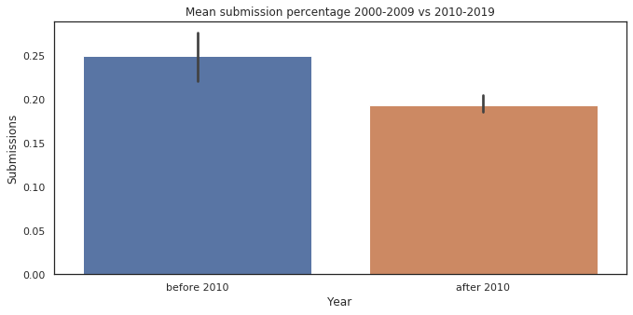
Submissions - Hypothesis test results
Same time periods as takedowns test.
Ho: p1 - p2 = 0
Ha: p1 - p2 ≠ 0
P = 0.0006.
Cohen’s d: 1.53
With a small p-value, we can reject the null hypothesis.
There is a statistically significant difference in proportion of fights ending in submissions.

Slide 11
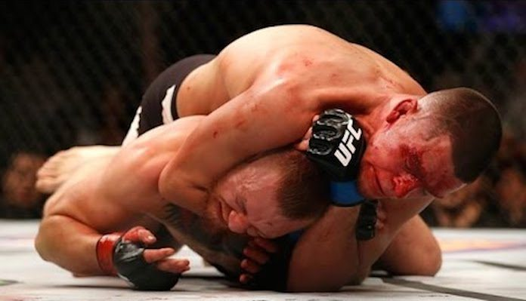
Conclusion
My original hypothesis that the proportion of fights ending in takedowns has gone down was supported by a z-test. I was able to reject the null.
Failed to reject the null hypothesis that there was a change in proportion of successful takedowns over time.
As I continue to improve my data science and analytics abilities, I'm excited to continue researching this topic to uncover more insights about UFC and mixed martial arts.
Nate Diaz, a BJJ black belt, submits Conor McGregor by rear-naked choke in March 2016
Notes:
Conclusion
Found that my original hypothesis that the proportion of fights ending in takedowns has gone down was supported by a z-test. I was able to reject the null.
Failed to reject the null hypothesis that there was a change in proportion of successful takedowns over time.
I'm not surprised by my findings on submissions. My guess as to why this is the case is that as time has gone on, more fighters are proficient at brazilian jiu jitsu, so the skills gaps between those who come from a BJJ background and those who don't has narrowed significantly. Also, as it develops as a sport, mixed martial arts will continue to evolve and refine as fighters introduce new techniques.
Brazilian Jiu Jitsu has become ingrained into the sport-- where other types of martial arts sank when put to the test, brazilian jiu jitsu rose to the top. But now and going forward, in order for a fighter to stay on top they'll need to have elite level ground AND striking abilities.
I think anyone who's interested in mixed martials arts would find valuable insightsd here. The intended audience can glean insights that help them think about where the future of the sport is going. It could be used by aspiring and current fighters to understand what fighting styles are important.
As I continue to improve my data science and analytics abilities, I'm excited to continue researching this topic to uncover more insights about UFC and mixed martial arts.

Slide 12
Thank you!

